Slide 1
Machine Learning
Gaussian Mixture Model - MLE)
(Courtesy: Lecture Slides on MLE by Mr. K. K. Singh)
.

Slide 2
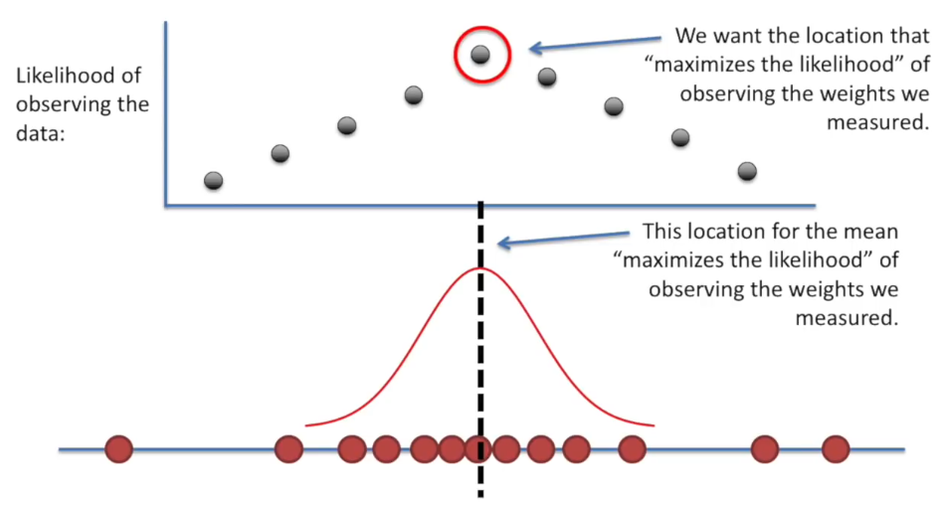
What is MLE?
MLE for mean

Slide 3
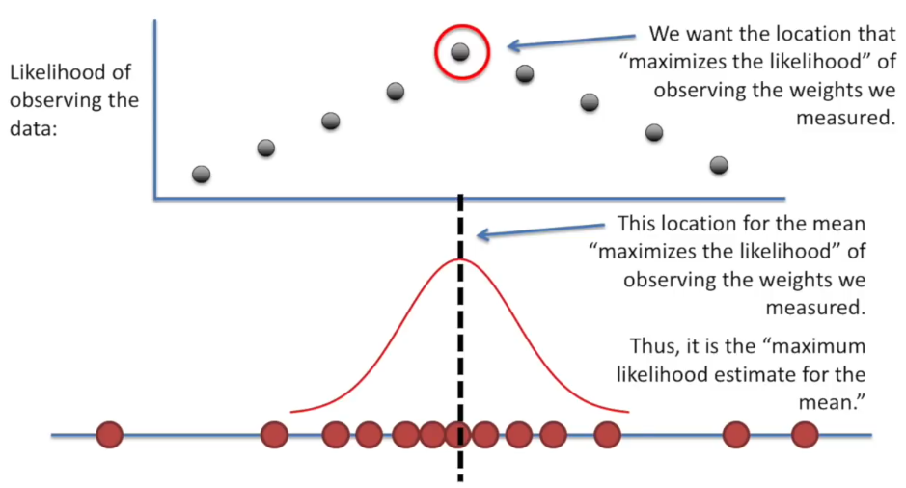
What is MLE?
MLE for mean

Slide 4
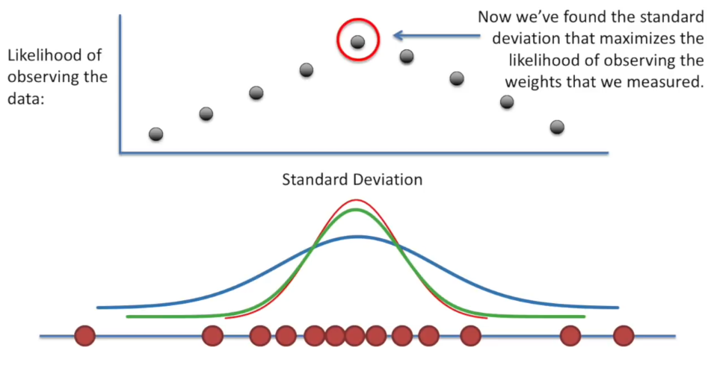
What is MLE?
MLE for standard deviation

Slide 5
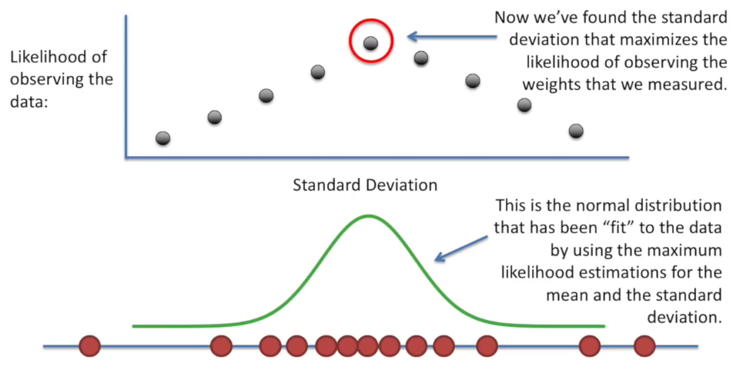
What is MLE?
MLE for mean and standard deviation

Slide 6
Introduction
We have a probabilistic model, M, of some phenomena.
We know exactly the structure of M, but not the values of its probabilistic parameters, θ.
Each “execution” of M produces an observation, x[i] , according to the (unknown) distribution induced by the model M.
Goal: After observing x[1] ,…, x[n] , estimate the model parameters, θ, that generated the observed data.
Notes:
i.I.d - idependent, identically distributed

Slide 7
Maximum Likelihood Estimation (MLE)
The likelihood of the observed data, given the model parameters θ, is the conditional probability that the model, M, with parameters θ, produces x[1] ,…, x[n] is given by.
L(θ)=Pr(x[1] ,…, x[n] | θ, M),
In MLE we seek the model parameters, θ, that maximize the likelihood.
The MLE principle is applicable in a wide variety of applications, from speech recognition, through natural language processing, to computational biology.
Notes:
i.I.d - idependent, identically distributed

Slide 8
Example: Binomial Experiment
When tossed, it can land in one of two positions:
Head (H) or Tail (T)
We denote by θ the (unknown) probability P(H).
Estimation task:
Given a sequence of toss samples x[1], x[2], …,x[M]
To estimate the probabilities P(H)=θ and P(T) = 1 - θ

Slide 9
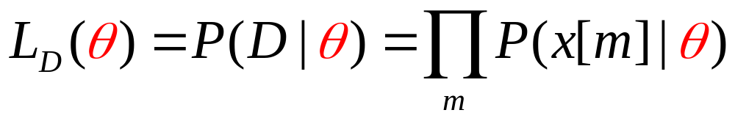
The Likelihood Function
How good is a particular θ?
It depends on how likely it is to generate the observed data
The likelihood for the sequence(x) H,T, T, H, H is
L(θ)
0
0.2
0.4
θ
0.6
0.8
1

Slide 10
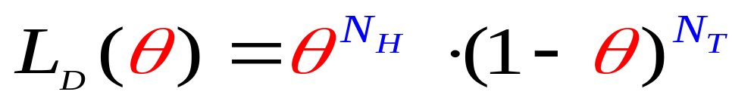
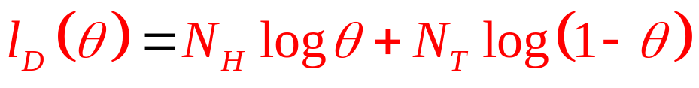
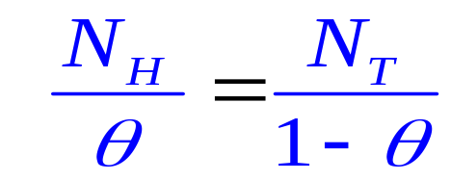
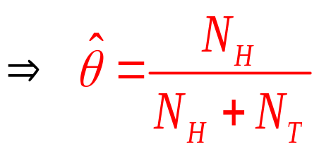
Example: MLE in Binomial Data
N_{H} and N_{T} are sufficient statistics for the binomial distribution
maximizes the log-likelihood function, defined as l_{D}(θ) = ln L_{D}(θ)
Taking derivative and
equating it to 0, we get
Example:
(N_{H},N_{T} ) = (3,2)
MLE estimate is 3/5 = 0.6
L(θ)
0
0.2
0.4
0.6
0.8
1

Slide 11
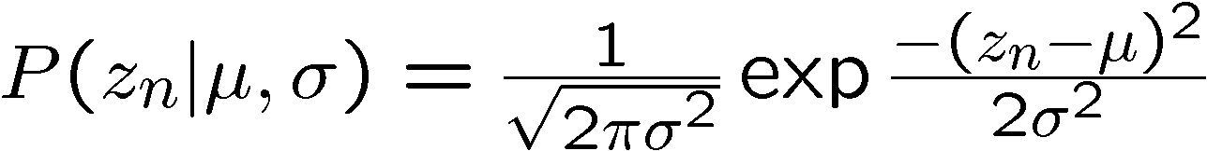
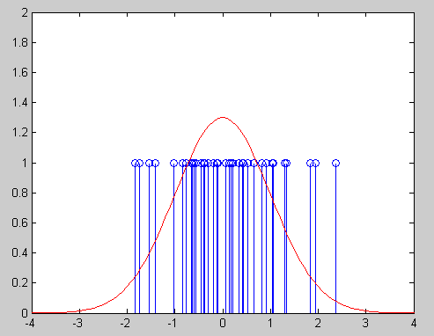
MLE for Univariate Gaussian Distribution
Maximum likelihood
parameter estimation:

Slide 12
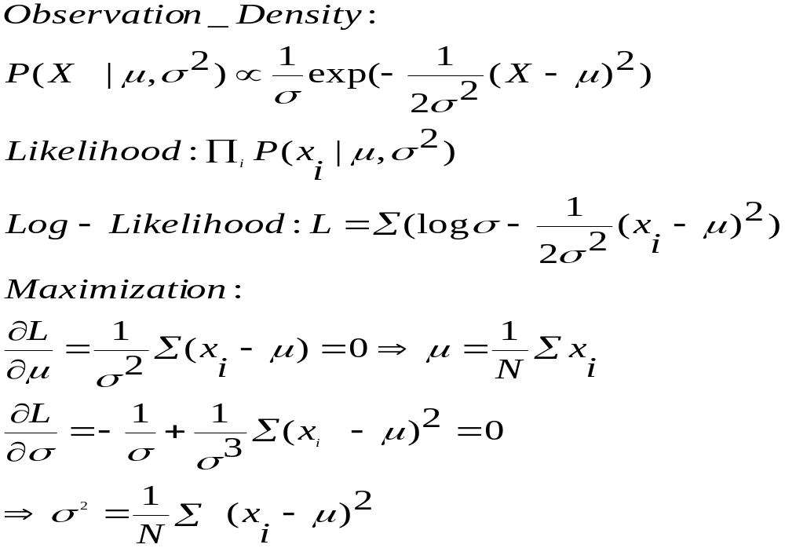
Derivation of MLE for Gaussians

Slide 13
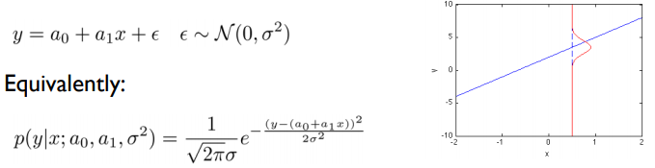
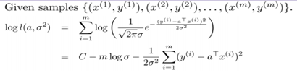
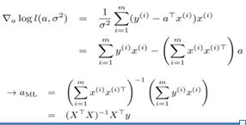

Estimating Linear Regression parameters using MLE

Slide 14
References
[1] https://www.youtube.com/watch?v=XepXtl9YKwc

Slide 15
Thank You

